Slide 1
INVENTORY OPTIMIZATION ANALYSIS
ToyJoy: Balancing Stock,
Seasonality & Demand
A data-driven review of 3 years of retail & online sales to reduce overstock,
prevent stockouts, and improve cash flow.

Slide 2
EXECUTIVE SUMMARY
The Inventory Imbalance, By The Numbers
$8.15M
51.4%
$1.04M
29 / 32
3-Year Revenue
Excess Inventory Share
Est. Lost Revenue
Products Chronically
Out of Stock
across 32 SKUs, 8 categories
of avg. stock sits in low-turnover SKUs
from stockouts over 3 years
stocked out in 15%+ of months
Demand is highly seasonal — December sales run 2.7x January levels — yet reorder cycles don't track that curve. The result: capital tied up in slow-moving toys while fast-movers run dry right when demand peaks. Fixing reorder timing and safety stock by category could recover a large share of the $1M+ in lost sales without growing total inventory spend.
METHOD
3 years (2023–2025) of monthly sales & inventory records across 32 products / 8 categories / 2 channels (Retail, Online). Category labels and stock counts were cleaned and standardized; missing values imputed at the product level (documented in Appendix).
2

Slide 3
BACKGROUND
Why This Analysis, Why Now
After the last holiday season, ToyJoy ended up with excess inventory of some products while others sold out at the worst possible time. This analysis pinpoints exactly where the imbalance is happening and what to do about it.
KPIs TRACKED
Units Sold per Product
1
Spot the imbalance
Inventory Turnover Rate
Identify products/categories with high overstock vs. chronic stockouts
Stockout Rate
2
Model seasonality
Excess Inventory Value
Map demand trends across holidays, back-to-school, and summer peaks
Seasonal Demand Patterns
3
Recommend action
Translate findings into reorder-point and stocking adjustments
Revenue Contribution per Product
3

Slide 4
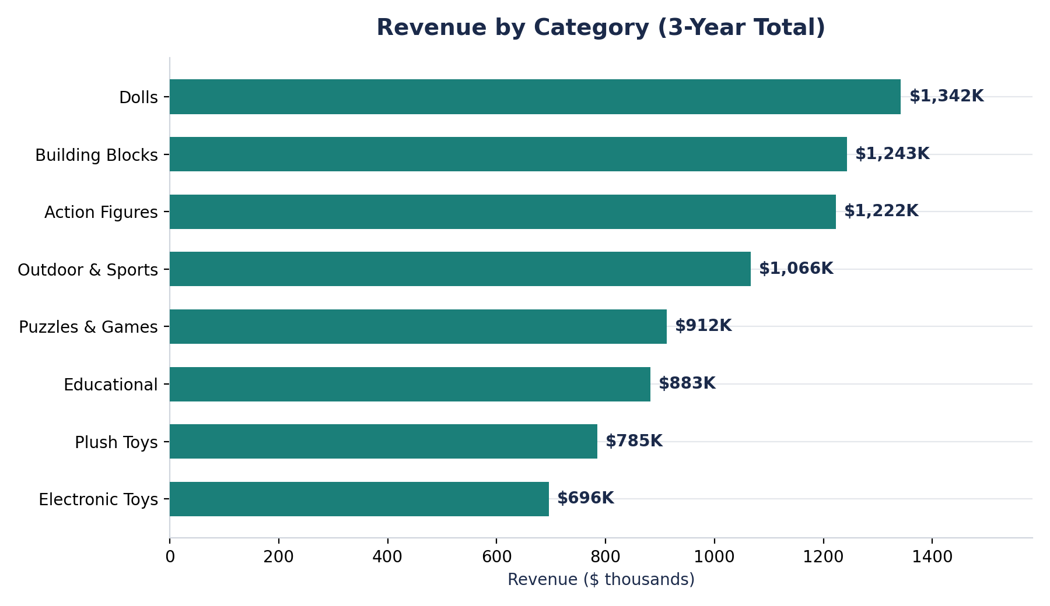
REVENUE & CATEGORY MIX
Dolls, Building Blocks & Action Figures Lead Revenue
READING THE MIX
•
Top 3 categories (Dolls, Building Blocks, Action Figures) generate 46.8% of total revenue.
•
Electronic Toys is the smallest revenue contributor (8.5%) despite premium price points — a volume problem, not a pricing one.
•
Revenue concentration means inventory decisions in the top 3 categories carry outsized cash-flow impact.
4

Slide 5
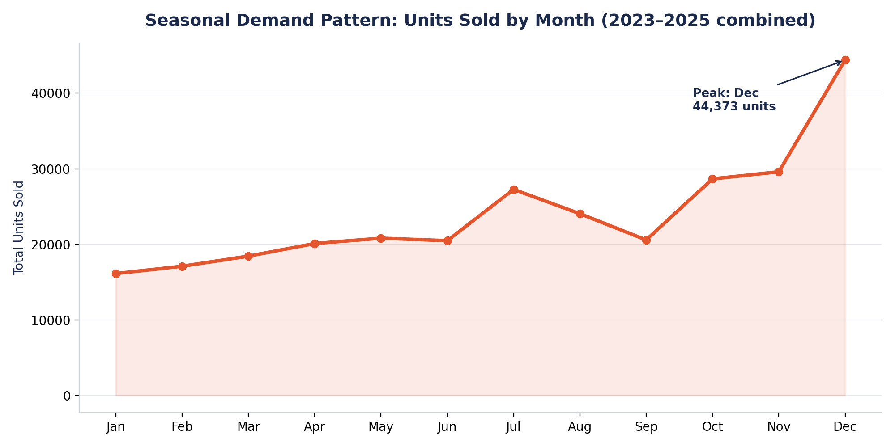
SEASONALITY
Demand Nearly Triples From January to December
SEASONAL DRIVERS
Oct–Dec
Holiday surge across Dolls, Action Figures & Building Blocks (up to 3x baseline)
Jun–Jul
Summer bump for Outdoor & Sports toys
Aug–Sep
Back-to-school lift for Educational products
5

Slide 6
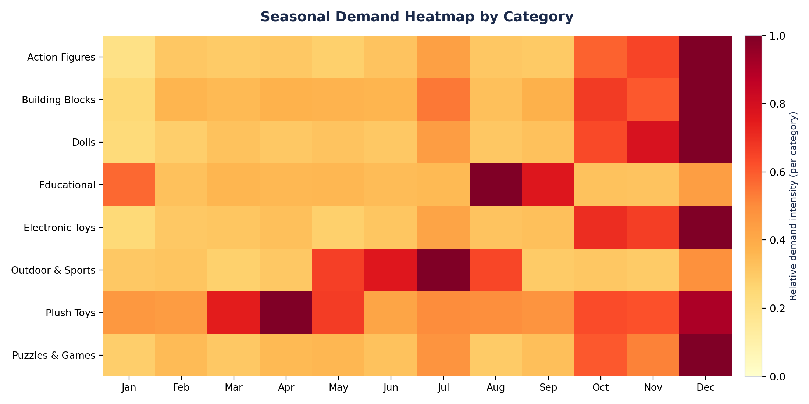
SEASONALITY BY CATEGORY
Each Category Peaks at a Different Time of Year
6

Slide 7
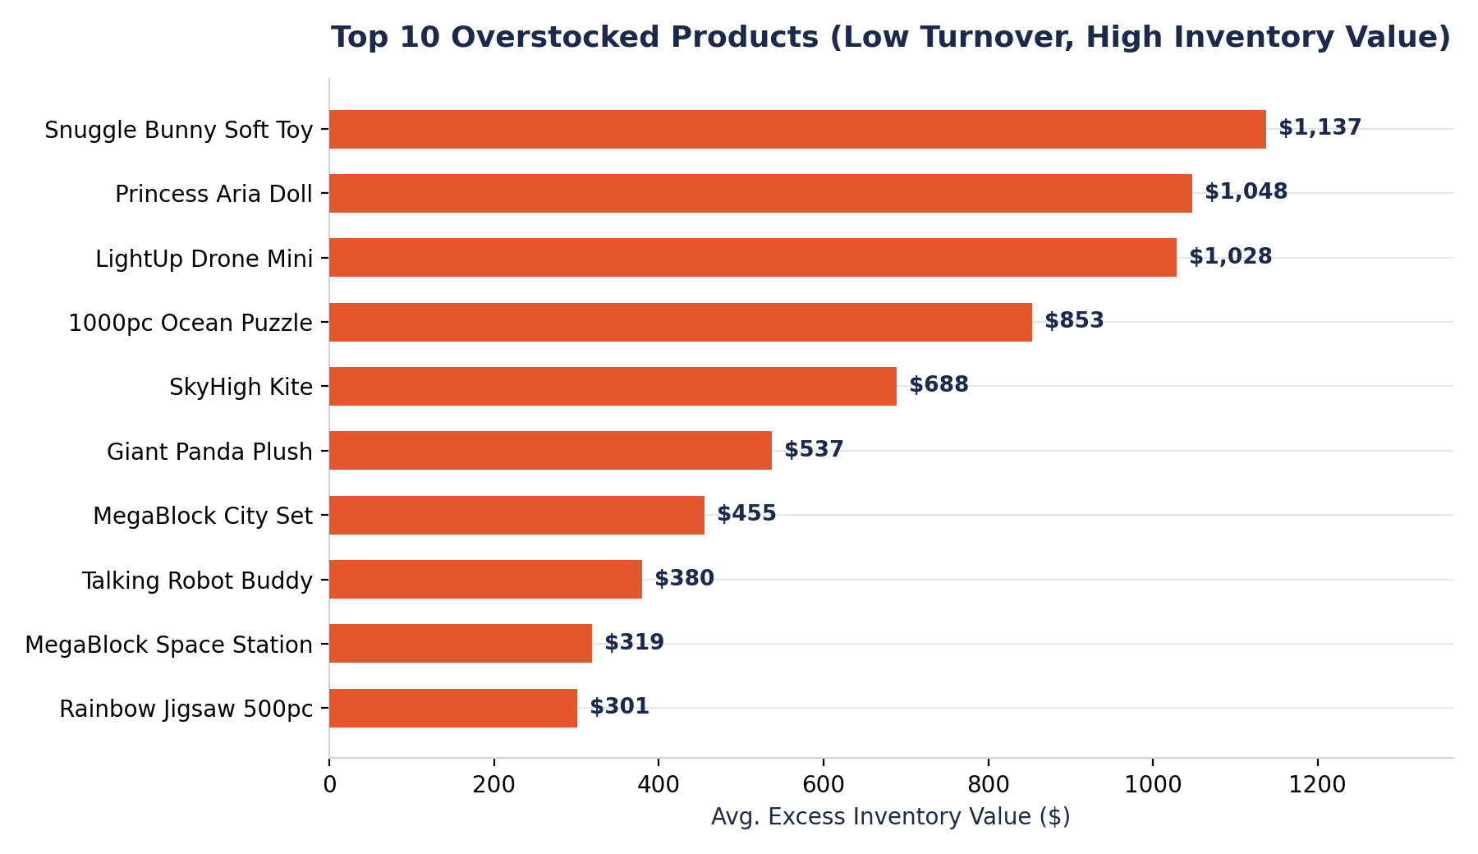
EXCESS INVENTORY
10 Products Are Tying Up Working Capital
WHAT'S GOING ON
•
These SKUs turn over far slower than the portfolio average — inventory sells 100–230x slower relative to stock on hand vs. top performers.
•
Snuggle Bunny Soft Toy and Princess Aria Doll carry the highest excess value: steady but low-volume sellers over-ordered on a fixed reorder cycle.
•
Puzzles & Games and Plush Toys categories account for the largest share of overstocked SKUs.
7

Slide 8
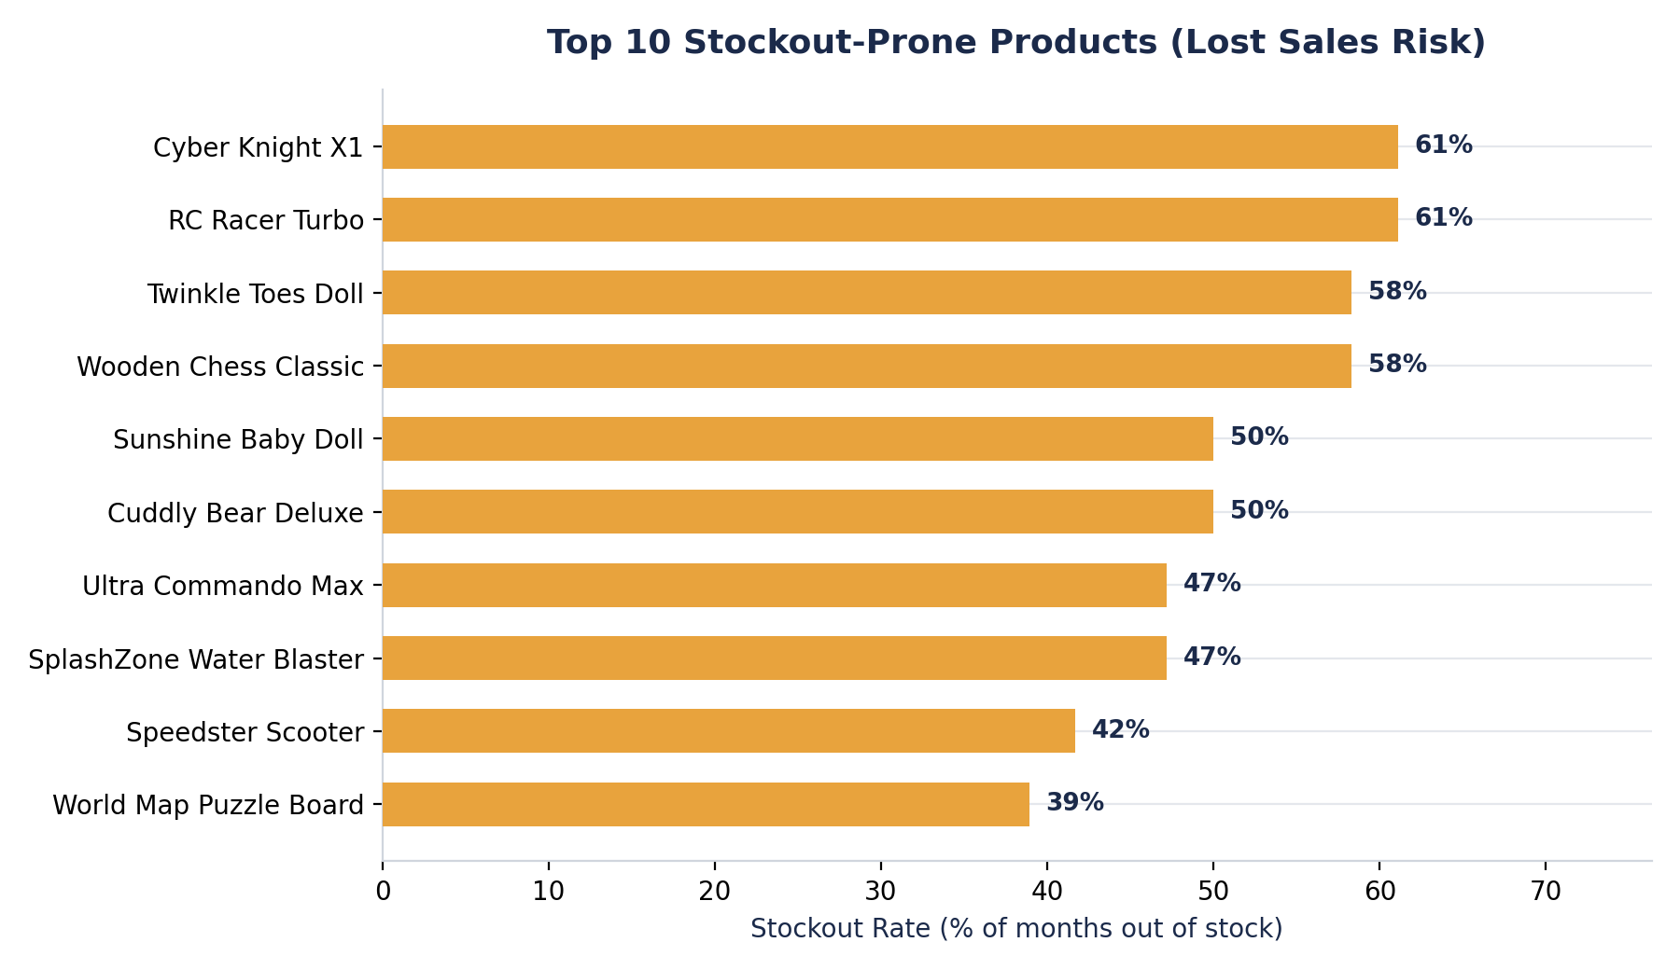
LOST SALES
Chronic Stockouts Are Costing ~$1M in Revenue
WHAT'S GOING ON
•
Cyber Knight X1 and RC Racer Turbo were out of stock in 61% of months — both are high-demand, rising-trend products under-ordered relative to their growth.
•
Twinkle Toes Doll alone accounts for an estimated 2,067 lost unit sales.
•
Action Figures and Electronic Toys have the highest average stockout rates (~39% and ~29% of months) despite strong per-unit revenue.
8

Slide 9
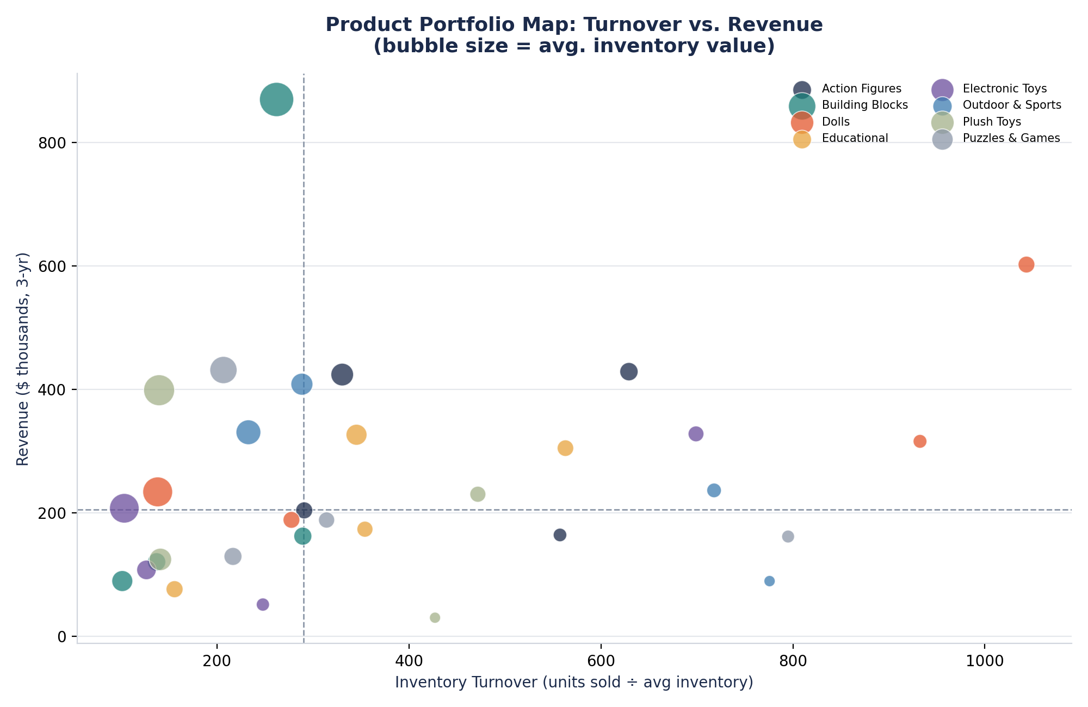
PRODUCT PORTFOLIO VIEW
Where Each Product Sits: Turnover vs. Revenue
QUADRANT GUIDE
Top-right
Stars — high revenue, fast turnover. Protect availability.
Top-left
Hidden gems — high revenue but slow turnover. Investigate pricing/promo.
Bottom-right
Fast but low-value — good candidates for bundling.
Bottom-left
Underperformers — low revenue, slow turnover. Candidates to discontinue or deep-discount.
9

Slide 10
RECOMMENDATIONS
Quick Wins and Long-Term Strategy
QUICK WINS (0–90 DAYS)
LONG-TERM STRATEGY
Discount or bundle the 10 overstocked SKUs (Snuggle Bunny, Princess Aria Doll, LightUp Drone, etc.) to free up ~$6.7K/month in tied-up capital per typical stocking cycle.
Move to category-specific, seasonally-weighted reorder points instead of one flat cycle for all products.
Rush-reorder Cyber Knight X1, RC Racer Turbo & Twinkle Toes Doll ahead of the next peak — these are the biggest lost-revenue drivers.
Build a rolling demand forecast (3-month lookahead) using the last 3 years of seasonal indices per category.
Shift restock timing to front-load Sept/Oct before the Oct–Dec surge, instead of the current flat quarterly cycle.
Set differentiated safety-stock buffers: higher for star performers heading into their peak season, lower for steady/underperforming SKUs.
Pause automatic reorders for the 3–5 lowest-turnover, lowest-revenue SKUs pending a pricing/assortment review.
Establish a quarterly portfolio review using the turnover-vs-revenue map to systematically retire bottom-left underperformers.
10

